Slide 1
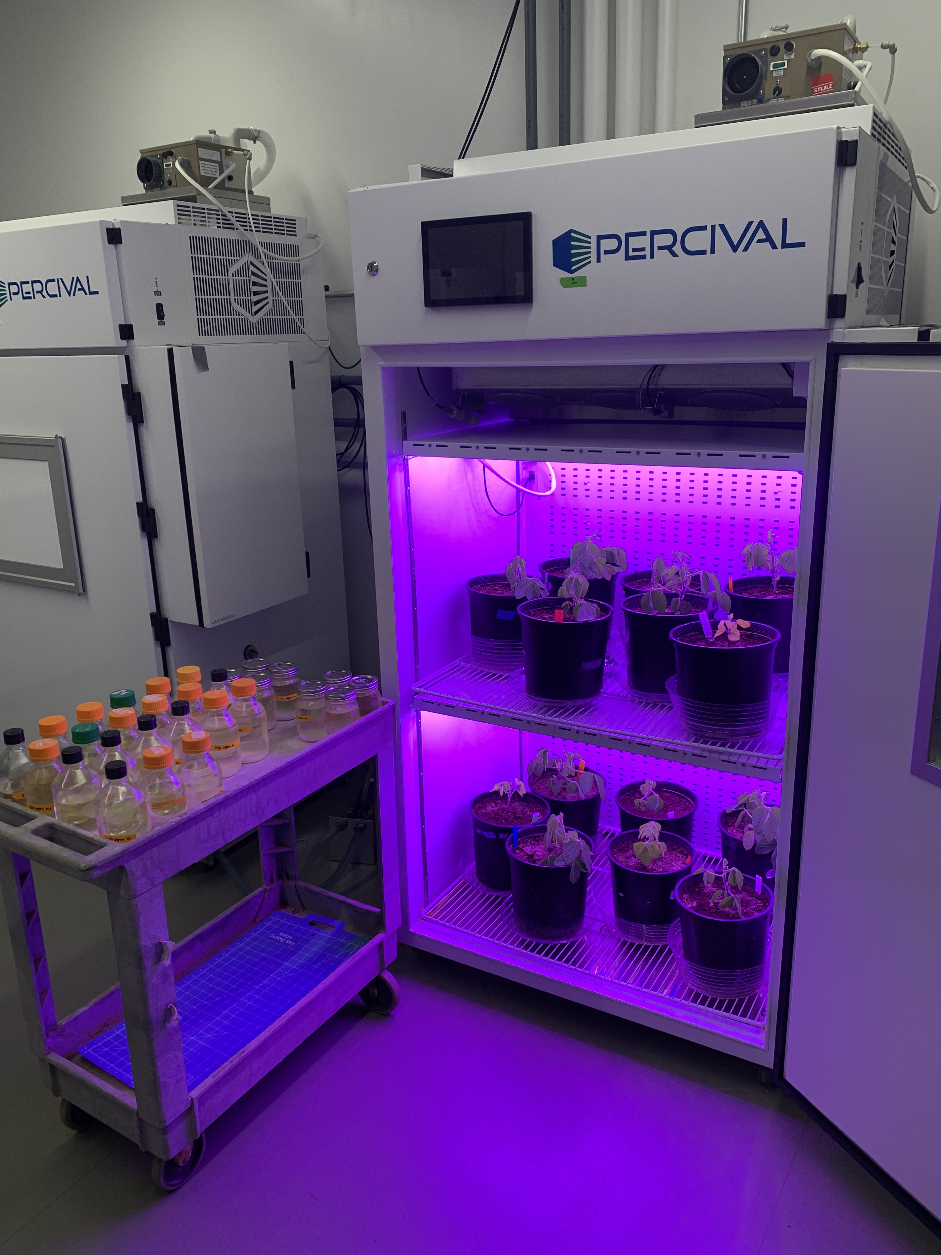

Nitrogen supply and demand control plant responses to elevated CO₂ at difference scales
Evan A. Perkowski
Ezinwanne Ezekannagha
Nicholas G. Smith

Slide 2
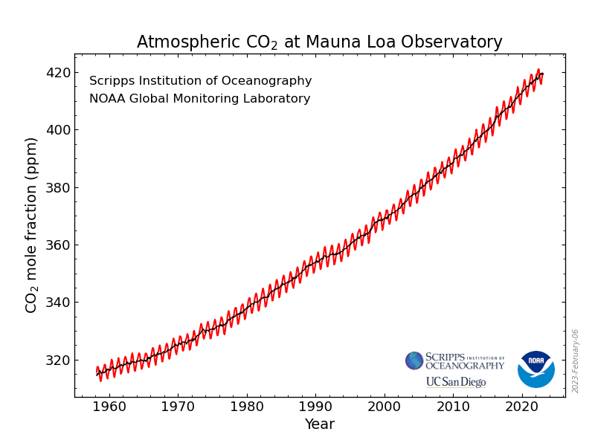
https://gml.noaa.gov/ccgg/trends/

Slide 3
33% increase in CO₂ concentration since 1960
61% of this increase has occurred since 1990
https://gml.noaa.gov/ccgg/trends/

Slide 4
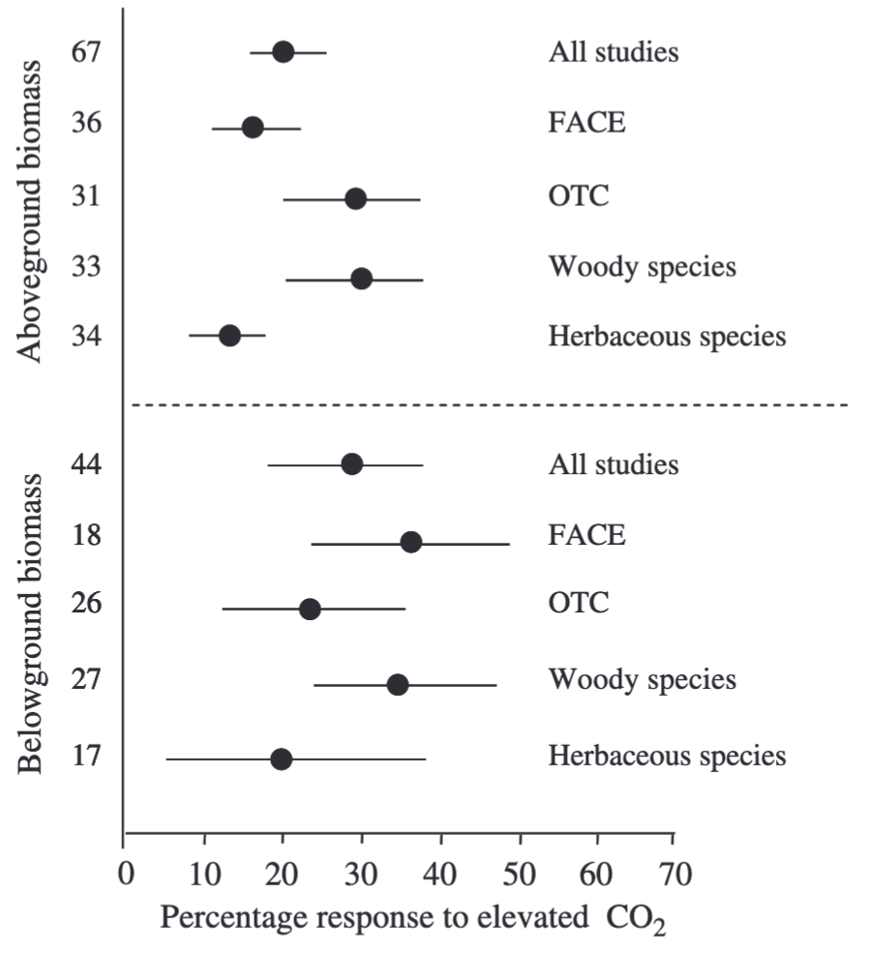
Plants grown under elevated CO₂ exhibit increased whole-plant growth
Aboveground biomass
Belowground biomass
de Graaf et al. (2006) Global Change Biology

Slide 5
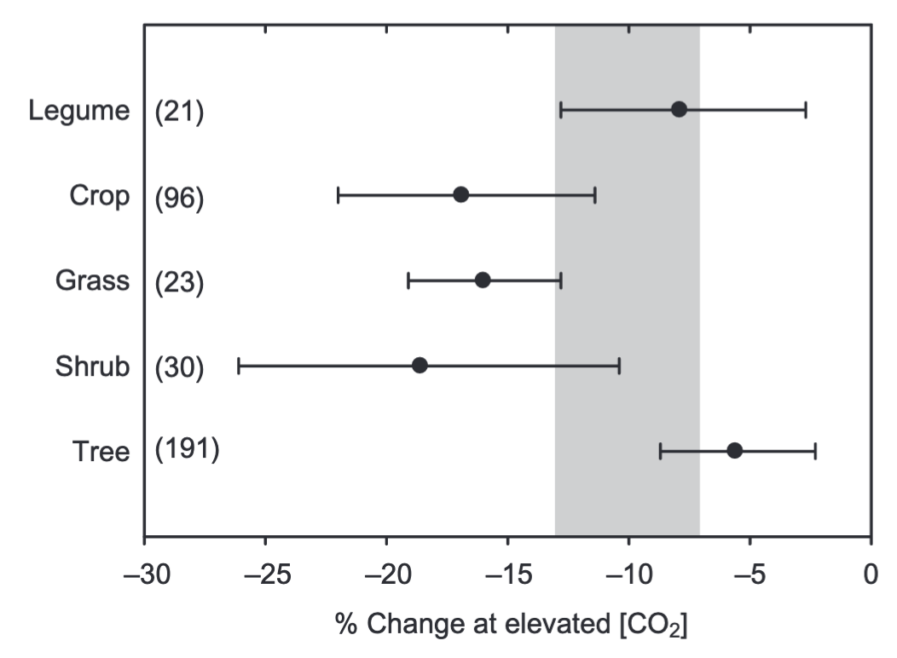
Plants grown under elevated CO₂ have reduced photosynthetic capacity
Photosynthetic capacity
Ainsworth & Rogers (2007) PC&E

Slide 6
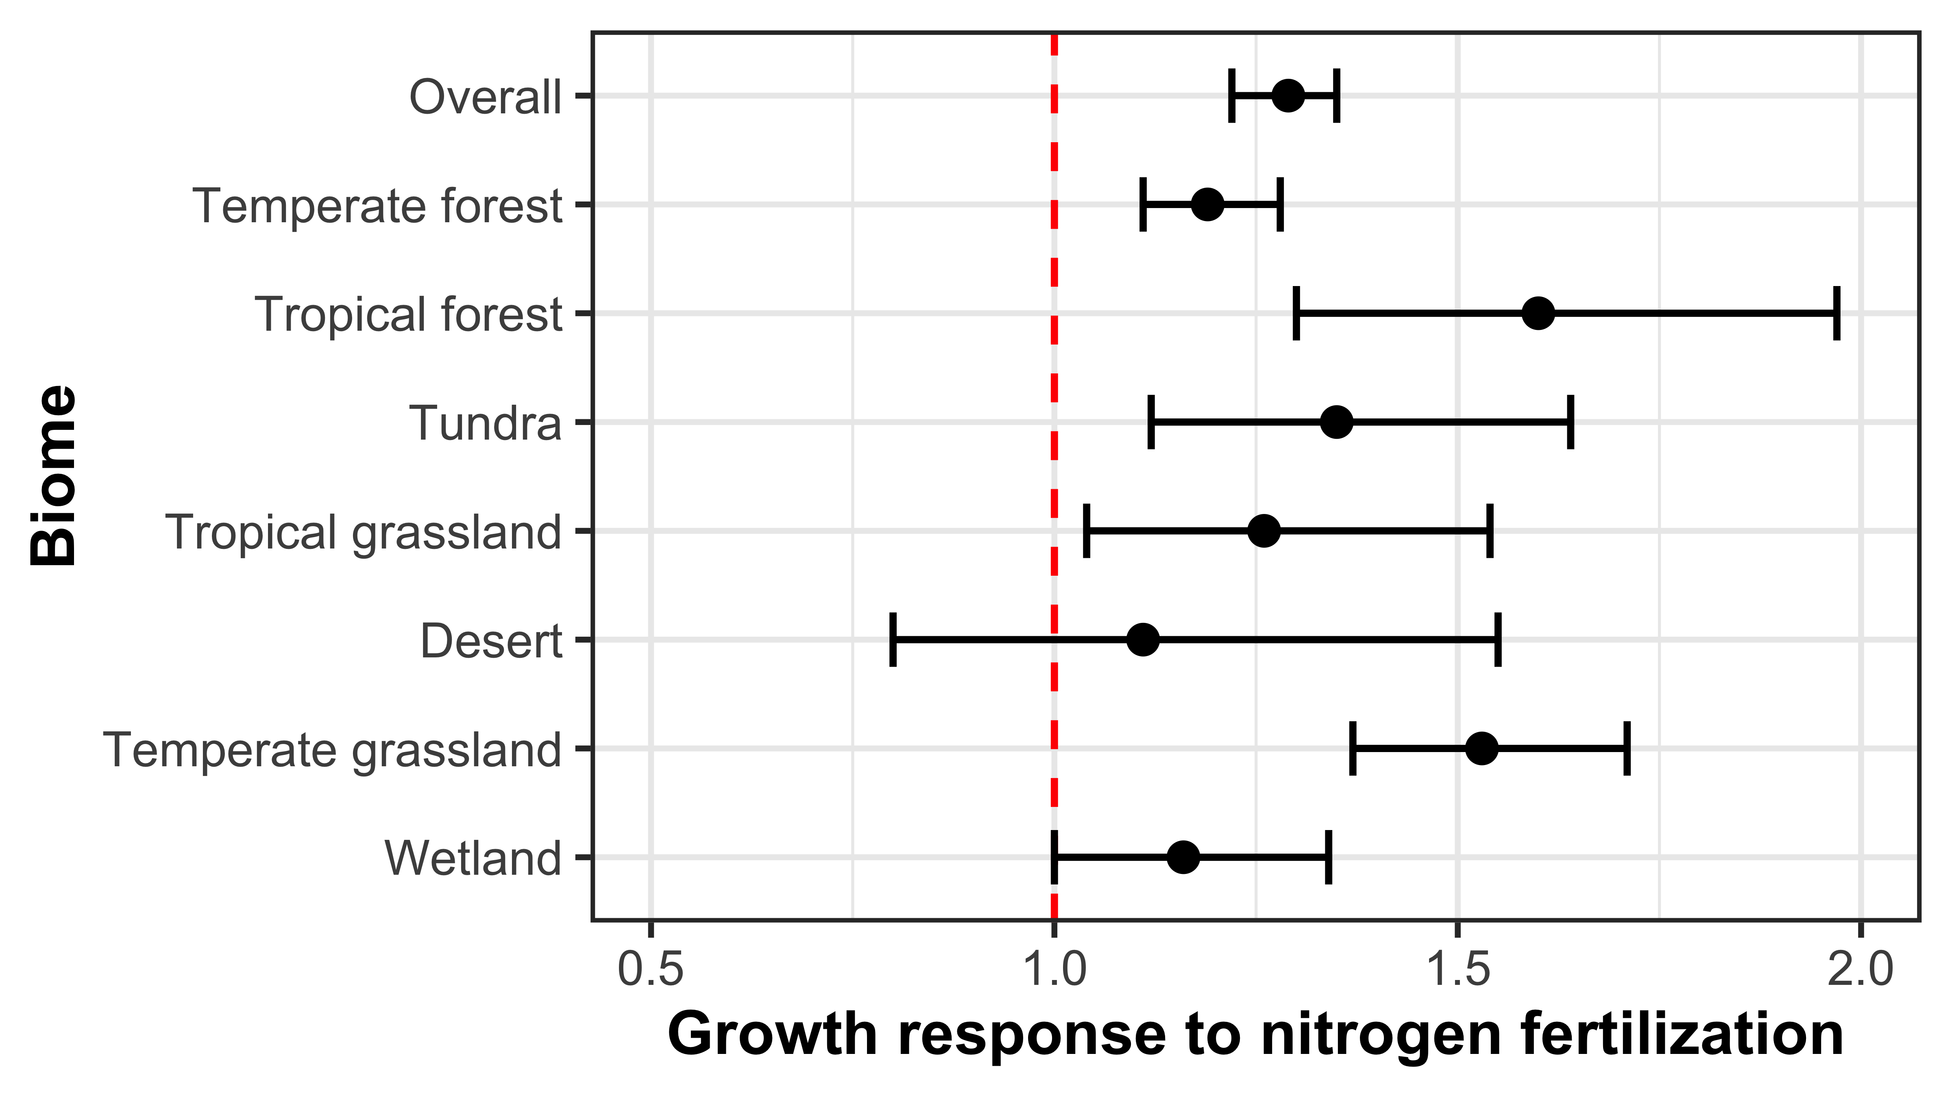
Nutrient availability limits net primary productivity
N addition increased
NPP across biomes by 29%
Figure adapted from LeBauer & Treseder (2008) Ecology

Slide 7
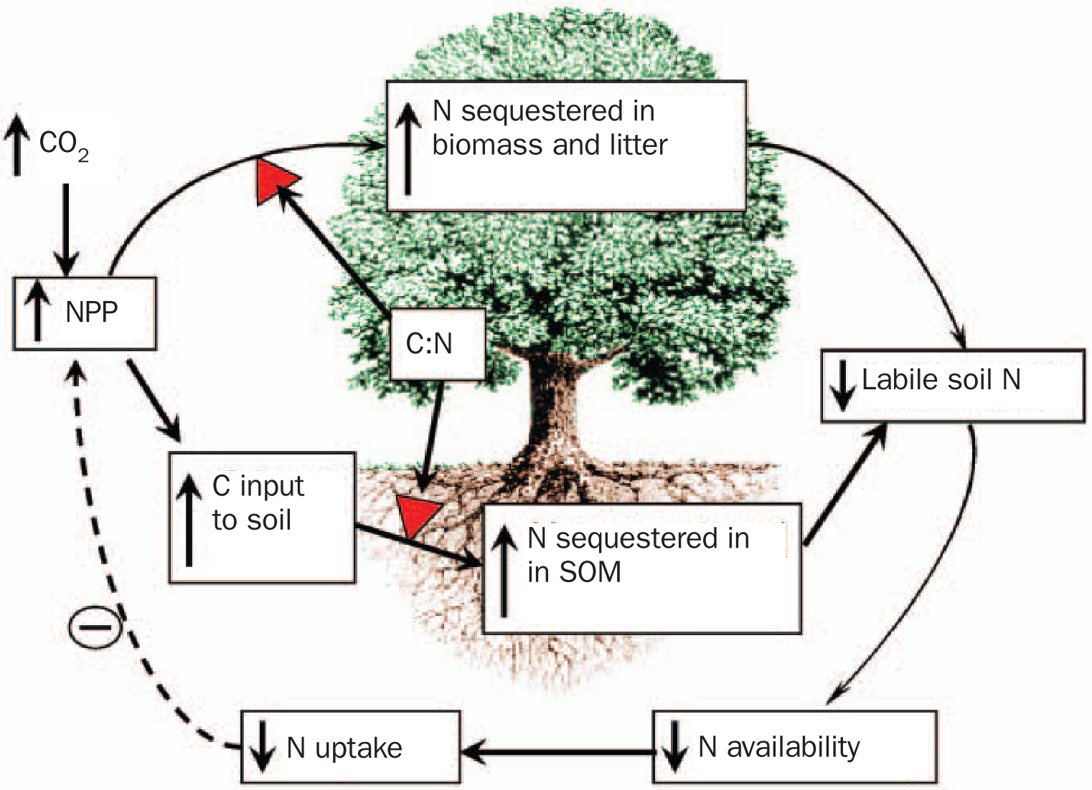
Nutrient limitation has been hypothesized to be the primary mechanism driving plant responses to CO₂
Luo et al. (2004) BioScience
Notes:
As nutrients commonly limit primary productivity globally, progressive nutrient limitation has been hypothesized…

Slide 8
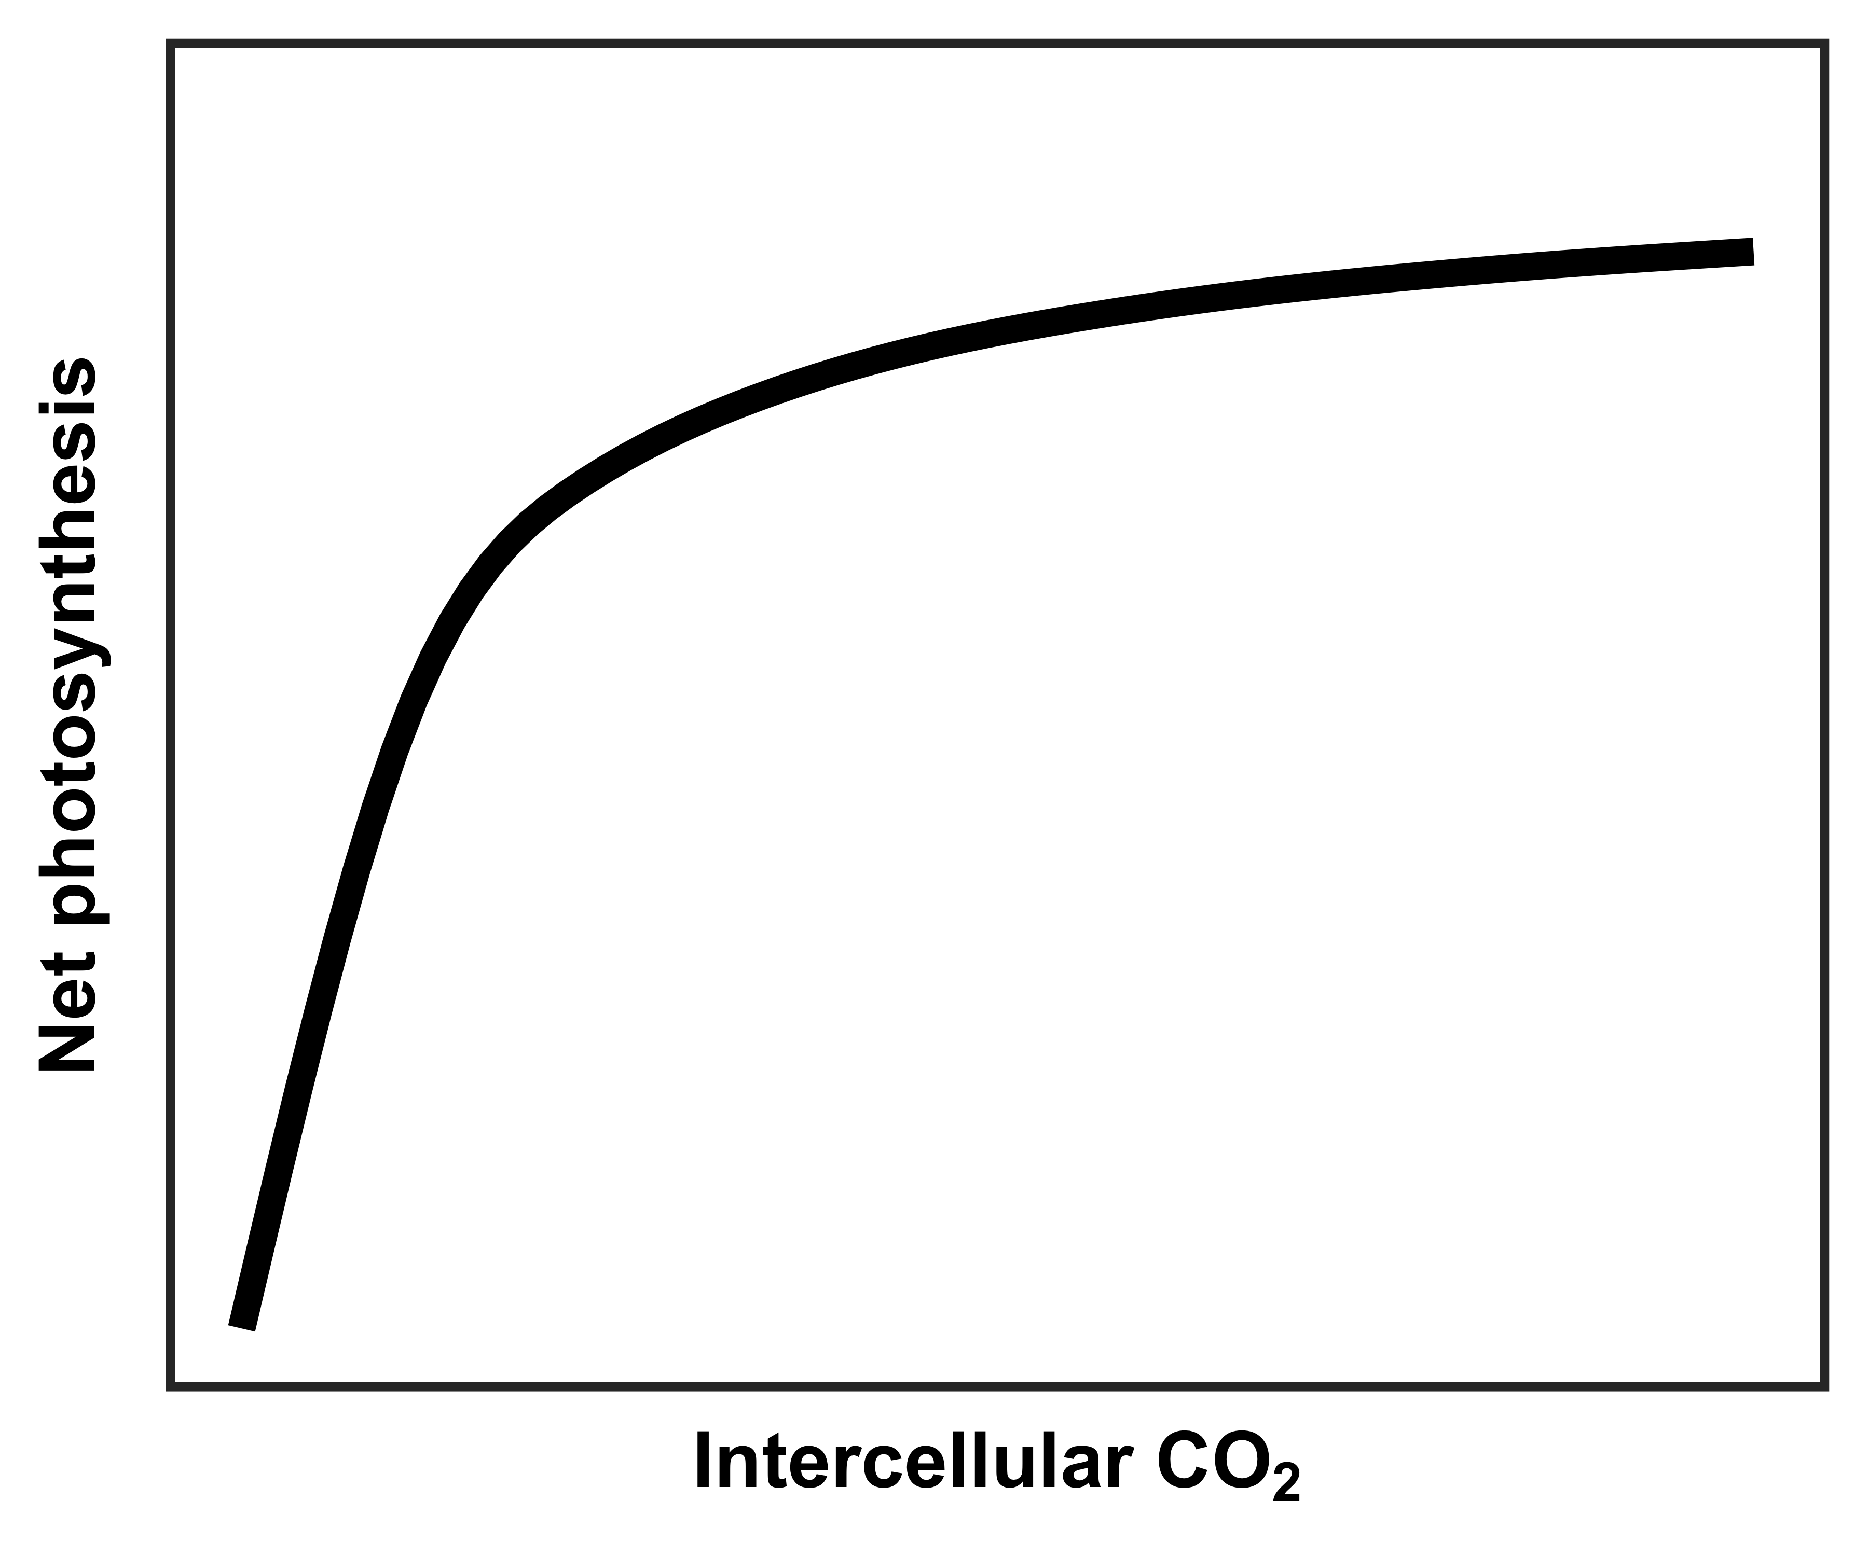
However, an alternative hypothesis suggests that plant demand to build and maintain photosynthetic enzymes drives the leaf response to CO₂
Figure adapted from Moore et al. (1999) PC&E

Slide 9
However, an alternative hypothesis suggests that plant demand to build and maintain photosynthetic enzymes drives the leaf response to CO₂
RuBP-limited photosynthesis
(A_{j})
Rubisco-limited photosynthesis
(A_{c})
net photosynthesis
at ambient CO₂
A_{c} = A_{j}
Figure adapted from Moore et al. (1999) PC&E

Slide 10
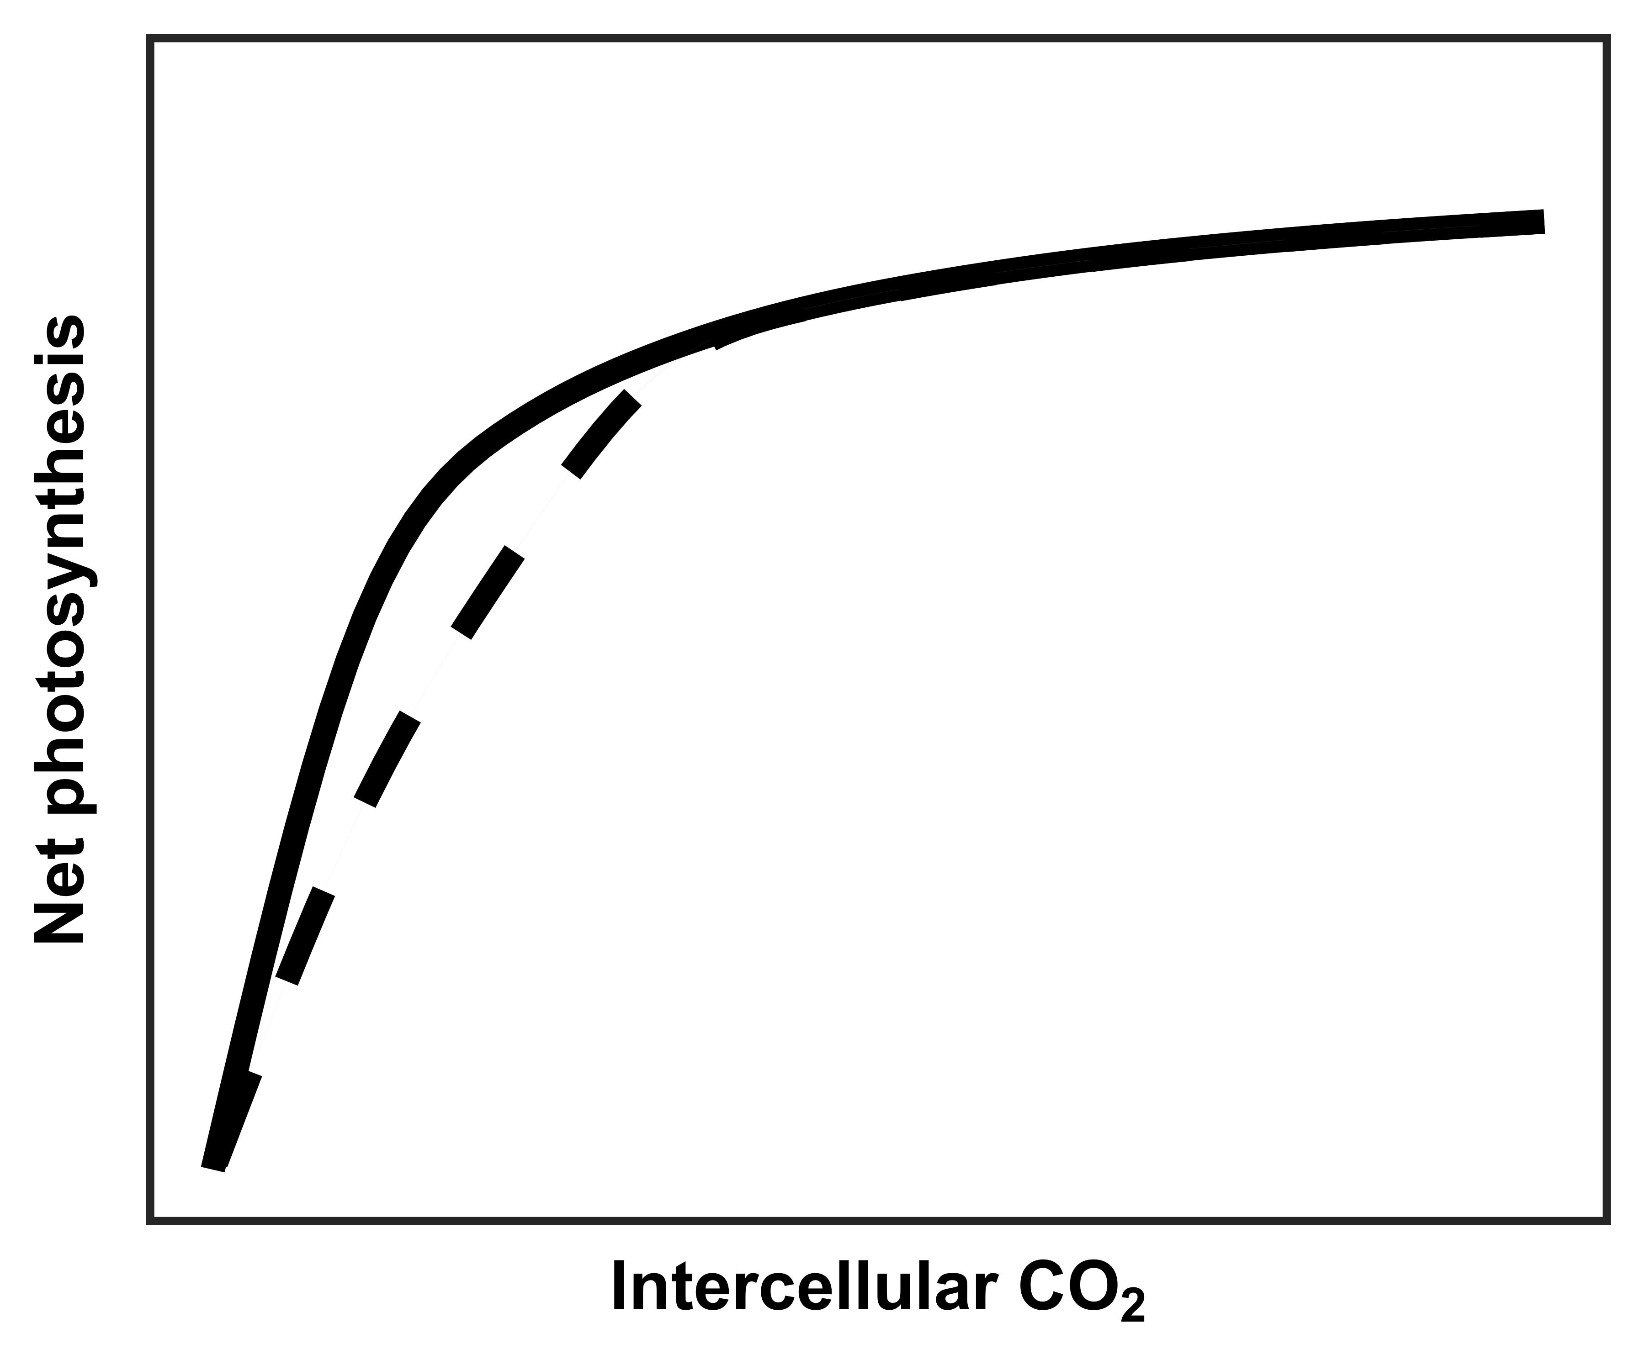
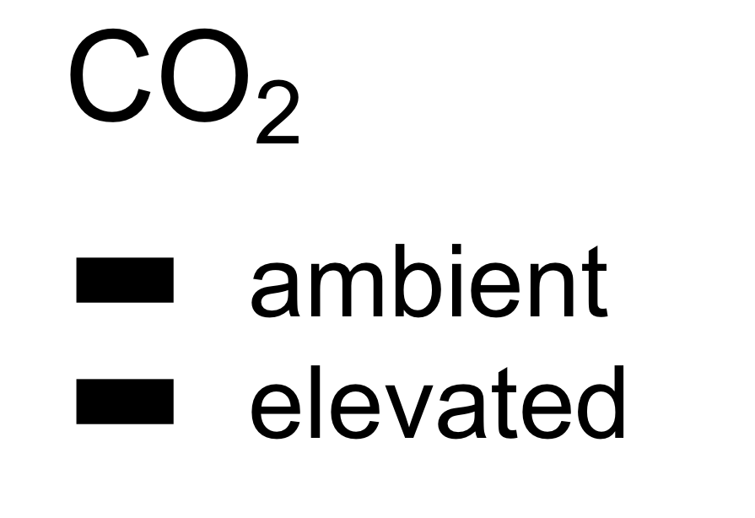
However, an alternative hypothesis suggests that plant demand to build and maintain photosynthetic enzymes drives the leaf response to CO₂
RuBP-limited photosynthesis
(A_{j})
Rubisco-limited photosynthesis
(A_{c})
net photosynthesis
at ambient CO₂
A_{c} = A_{j}
net photosynthesis
at elevated CO₂
Figure adapted from Moore et al. (1999) PC&E

Slide 11
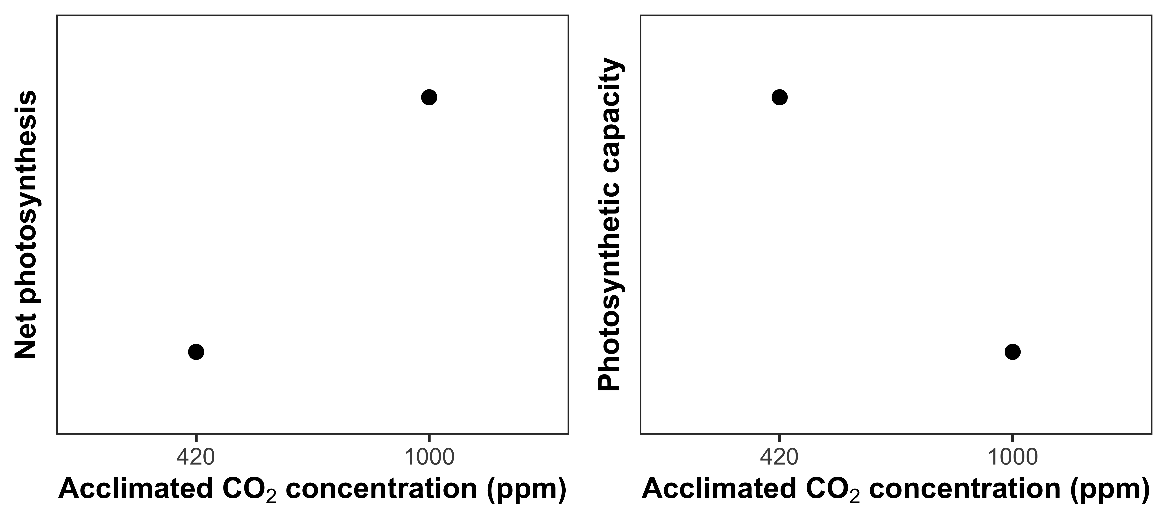
Optimal resource investment to photosynthetic enzymes increases leaf photosynthesis at lower nutrient use
Reduced nutrient allocation to photosynthetic enzymes
Increased net photosynthesis
rate
Notes:
As another example to illustrate this…

Slide 12
Study Question
How does soil nitrogen availability modify leaf and whole plant responses to CO₂?

Slide 13
Nitrogen limitation
hypothesis
eCO₂
Photosynthetic capacity
Soil N supply
Whole-plant growth
= net positive effect
= net negative effect
= null effect

Slide 14
Nitrogen limitation
hypothesis
Optimality
hypothesis
eCO₂
Photosynthetic capacity
eCO₂
Photosynthetic capacity
Soil N supply
Whole-plant growth
Soil N supply
Whole-plant growth
= net positive effect
= net negative effect
= null effect

Slide 15
Experiment setup
Acquisition strategy
Soil N treatments
0 ppm N
+ BNF
35 ppm N
- BNF
70 ppm N
105 ppm N
CO₂ treatments
140 ppm N
210 ppm N
ambient (420 ppm)
280 ppm N
elevated (1000 ppm)
350 ppm N
630 ppm N
Perkowski et al. (in prep)

Slide 16
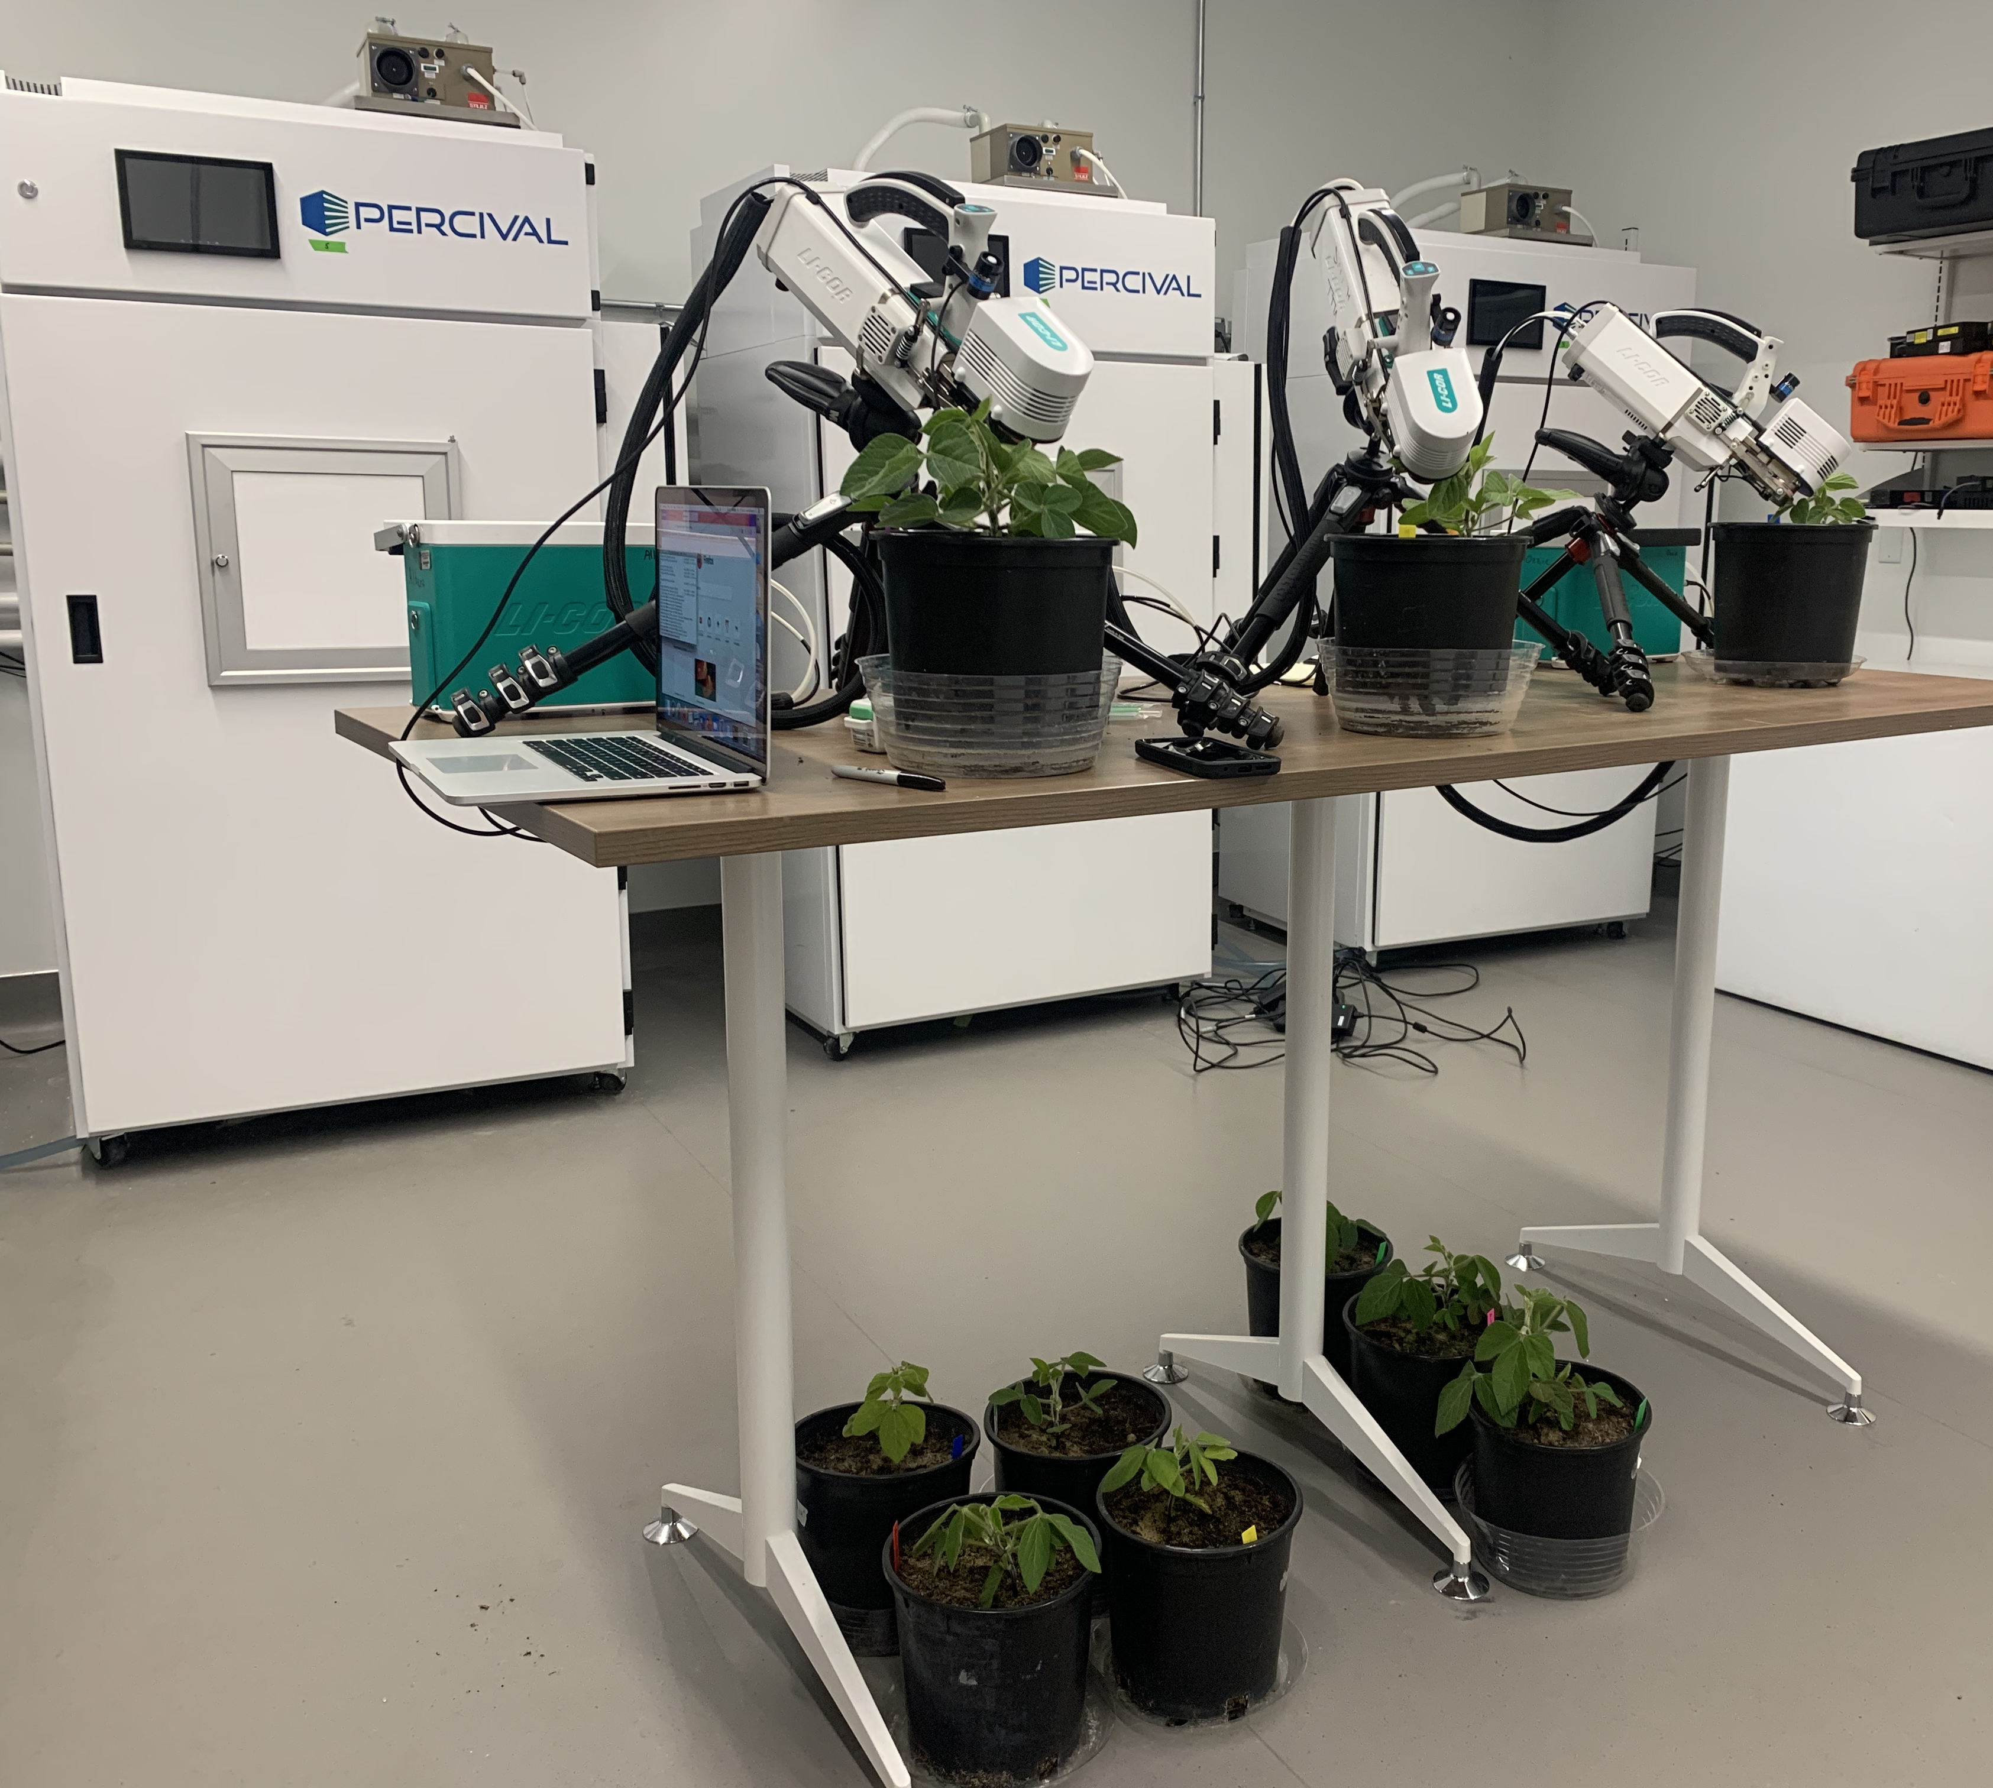
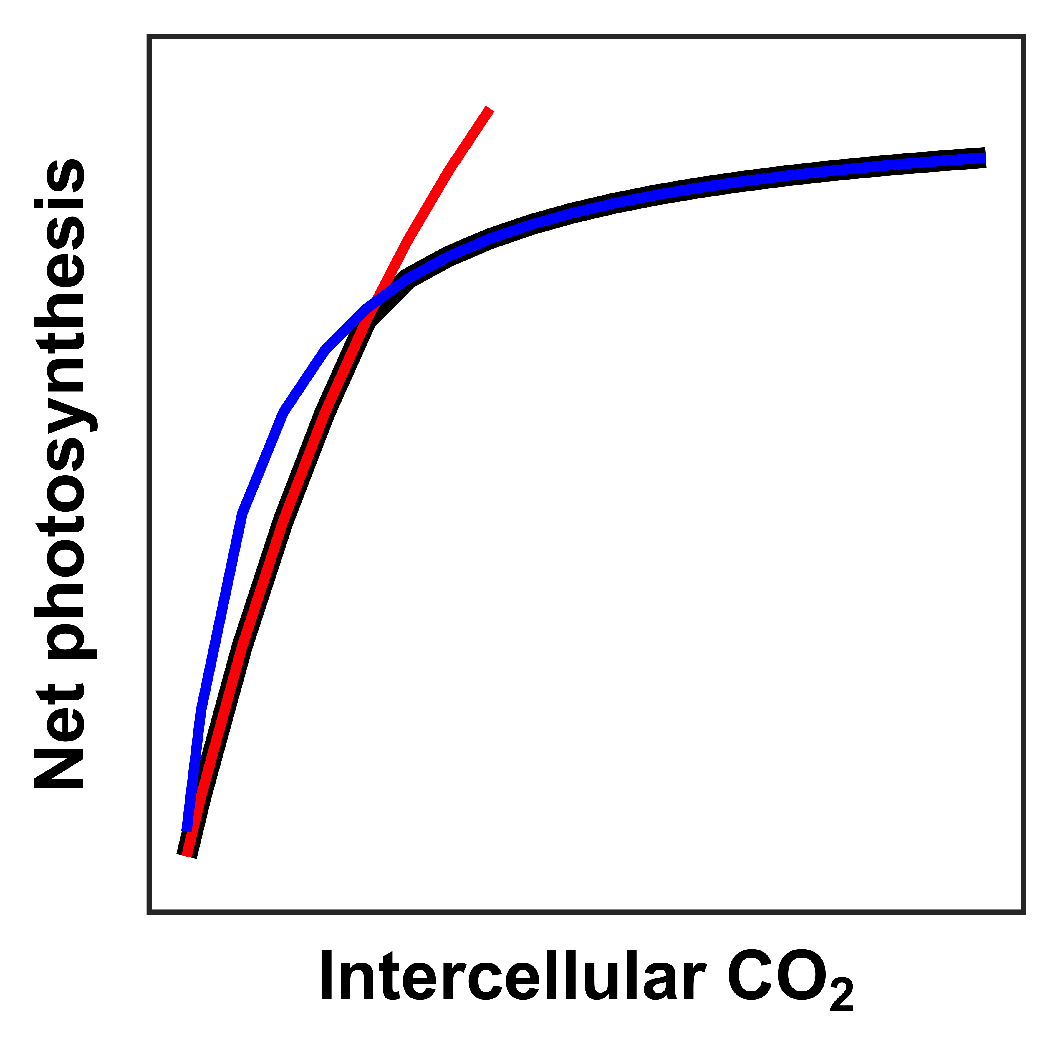
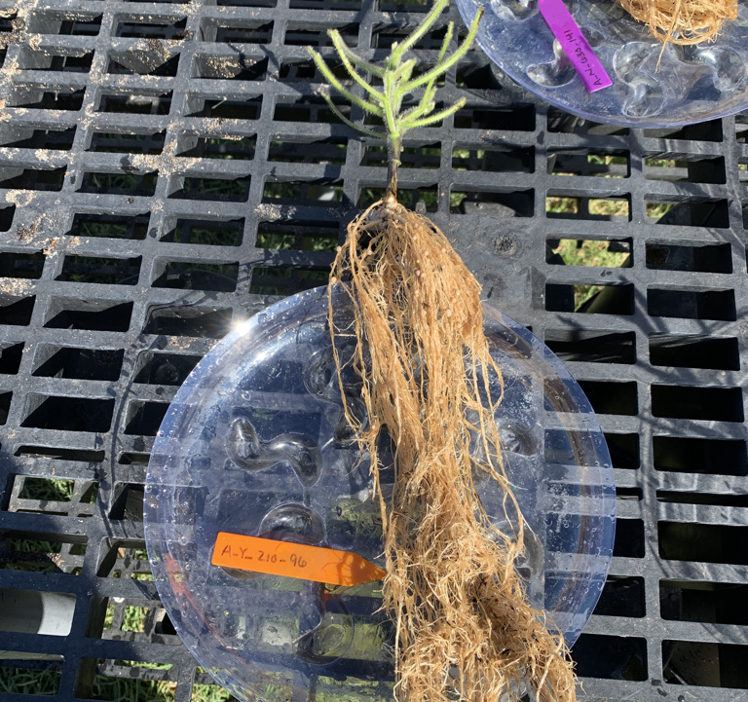
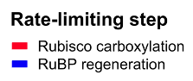
Measurements
Leaf trait
Whole plant trait
Leaf biochemistry
V_{cmax25}
J_{max25}
J_{max25}:V_{cmax25}
Total biomass
Perkowski et al. (in prep)

Slide 17
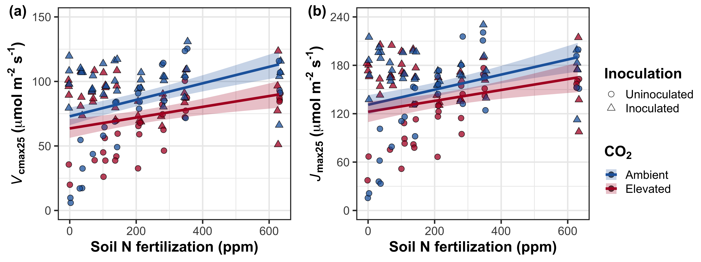
Elevated CO₂ decreased photosynthetic capacity independent of fertilization or inoculation
CO₂: | p<0.001
N: | p<0.001
Inoculation: | p<0.001
CO₂ interactions: | All NS
Notes:
Elevated CO2 reduced leaf biochemical process rates
Soil nitrogen fertilization generally increased leaf biochemical process rates, but the slope of this relationship was similar between both CO2 treatments
Indicates that the reduction in photosynthetic capacity under elevated CO2 was independent of fertilization

Slide 18
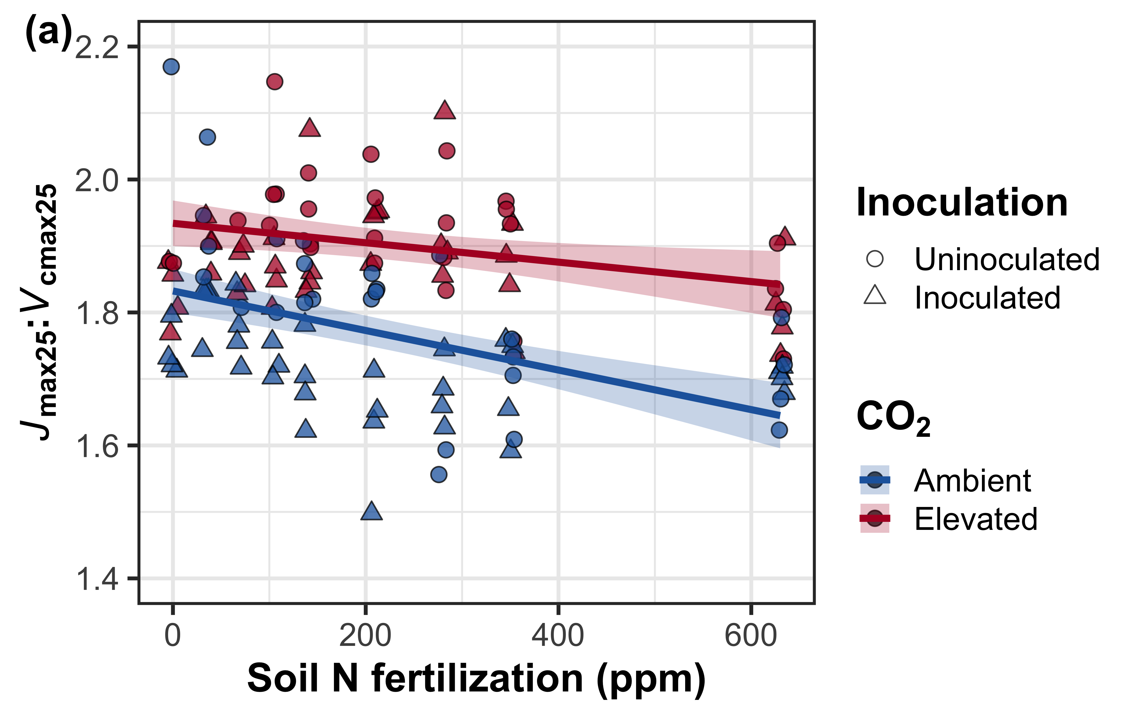
Elevated CO₂ decreased V_{cmax25} more strongly than J_{max25}. Patterns independent of fertilization or inoculation
CO₂: | p<0.001
N: | p<0.001
Inoculation: | p<0.001
CO₂ interactions: | All NS
Notes:
Optimal resource investment = stronger downregulation in Vcmax than Jmax

Slide 19
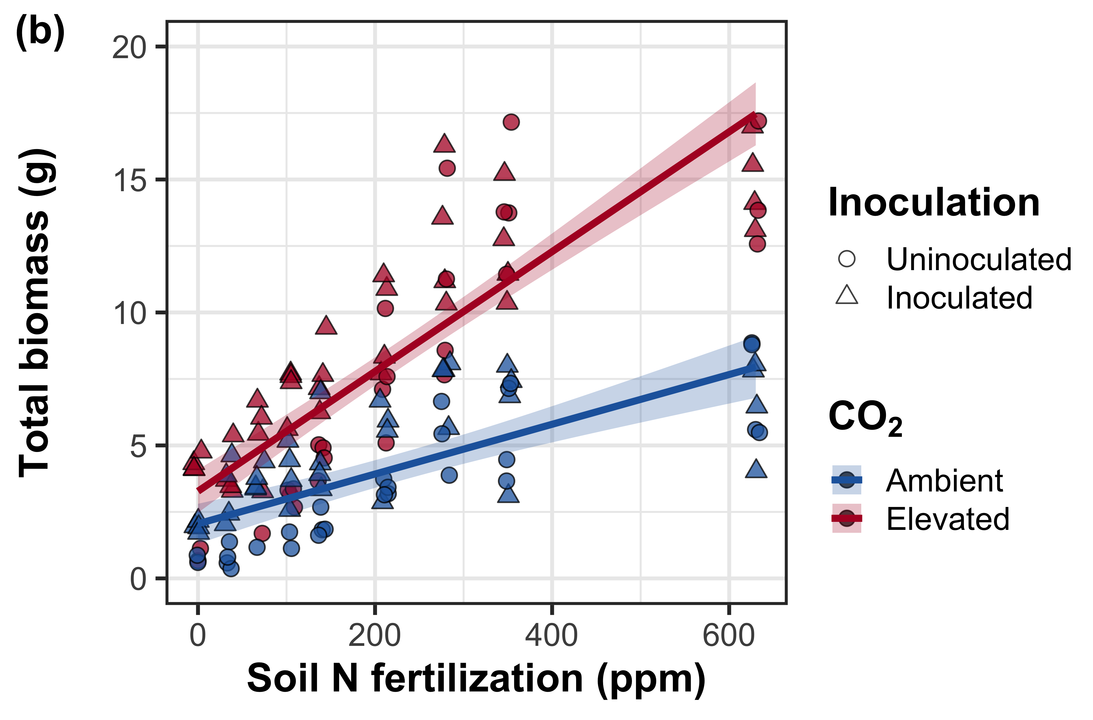
Increasing fertilization increased the positive effect of elevated CO₂ on whole-plant growth
CO₂: | p<0.001
N: | p<0.001
Inoculation: | p<0.001
CO₂*N: | p<0.001
CO₂*I: | NS
Perkowski et al. (in prep)
Notes:
Despite reductions in photosynthetic capacity and leaf nitrogen allocation at the leaf level, I observe strong stimulations in whole plant growth under elevated CO2

Slide 20
Conclusions
Nitrogen demand and supply control plant responses to eCO₂ at different scales
N supply → whole-plant response to eCO₂
N demand → leaf response to eCO₂
eCO₂
Photosynthetic capacity
Soil N supply
Whole-plant growth

Slide 21



Acknowledgements
Mylea Lovell (TTU IGCAST Phytotron manager)
University of California-Davis Stable Isotope Facility
EcoHealth Lab at Texas Tech University
Brad Posch
Alissar Cheaib
Eve Gray
Monika Kelley
Isa Beltran
Snehanjana Chatterjee

Slide 22
Thank you!

Slide 23
Extra slides

Slide 24
Soil N fertilization only influences leaf biochemical process rates in uninoculated pots
Perkowski et al. (in prep)

Slide 25
Inoculation reduced the negative effect of increasing fertilization on costs to acquire nitrogen
Perkowski et al. (in prep)

Slide 26
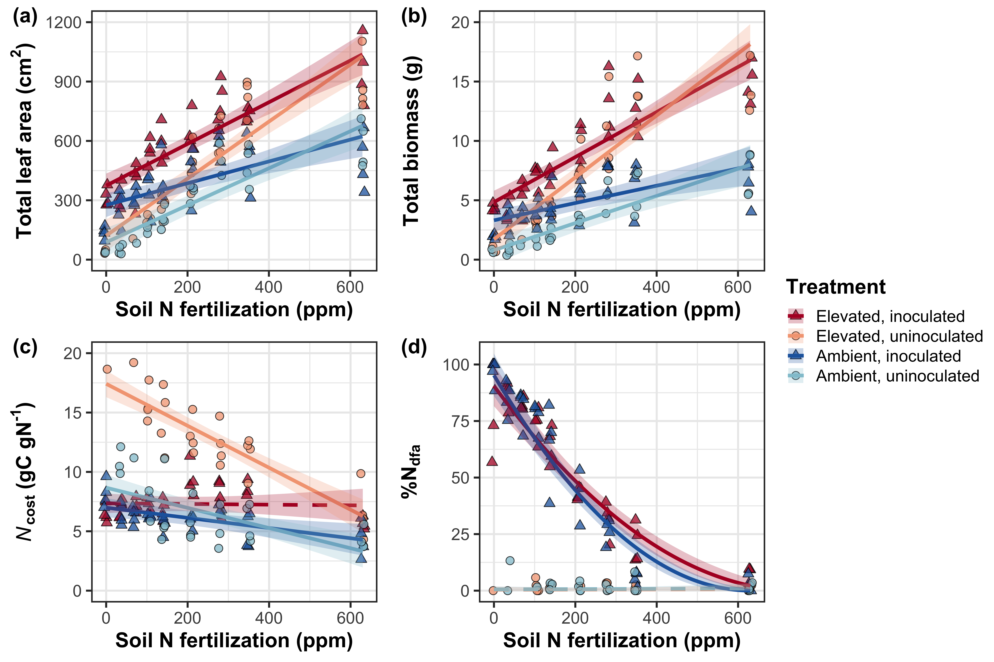
Plants reduce investment in nitrogen fixation with increasing fertilization
Perkowski et al. (in prep)

